Slide 1

The Peripheral Nervous System
GTHBY
Year 12 General Human Biology

Slide 2
Review
Draw a labelled diagram to show the components of the CNS and PNS.
Summarise the functions of the CNS
Summarise the functions of the PNS

Slide 3
True/False
The brain is part of the central nervous system.
The peripheral nervous system coordinates and integrates sensory information with actions.
The spinal cord’s main function is the transmission of nerve impulses to and from the body.
The peripheral nervous system is divided into autonomic and somatic.

Slide 4
Learning Intentions
Role of the functional divisions of the peripheral nervous system
autonomic – sympathetic and parasympathetic
somatic – sensory and motor

Slide 5
Success Criteria
Identify components of the peripheral nervous system
Define autosomal and somatic
Define parasympathetic and sympathetic
Define sensory and motor
Classify or give examples for each

Slide 6
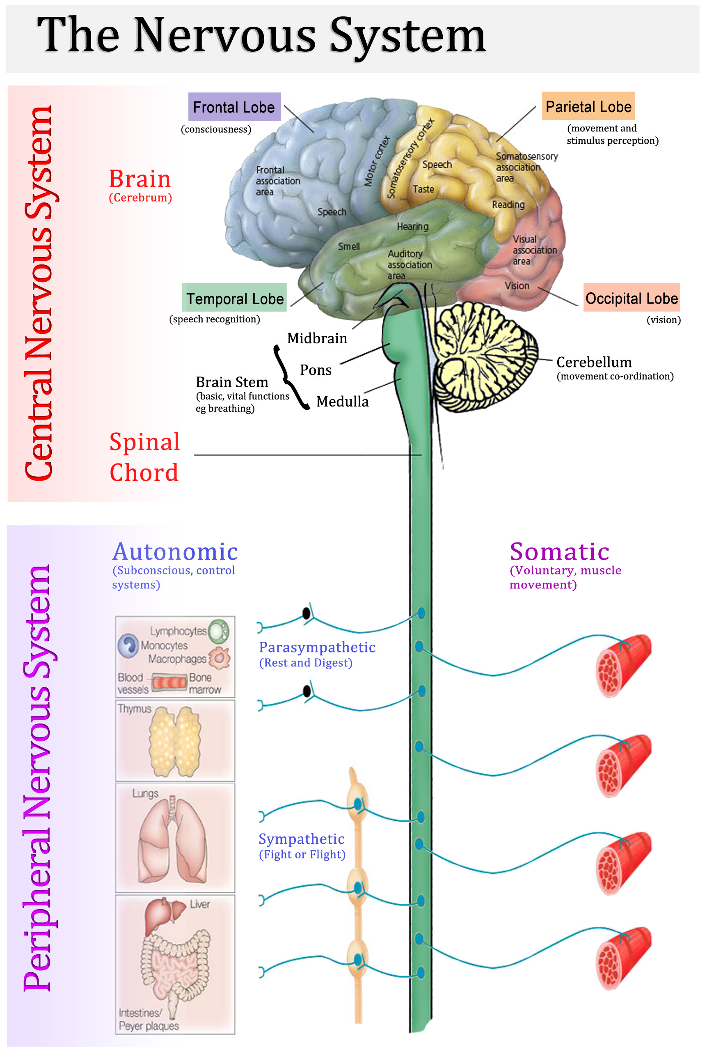

Slide 7
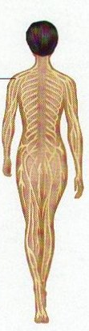
The Peripheral Nervous System
Nerves make up the peripheral nervous system. The function of the peripheral nervous system is the transmission of nerve impulses.
Two subsystems of the PNS are autonomic and somatic

Slide 8
Autonomic nervous system
Processes that run automatically without you having to think about them, eg internal organs and glands
Heart rate
Blood Pressure
Respiration
Digestion
Sexual arousal

Slide 9


Slide 10
Autonomic nervous system
Consists of calming parasympathetic “rest and digest” nerves and arousing sympathetic “fight or flight” nerves.
Can be stimulatory or inhibitory.

Slide 11
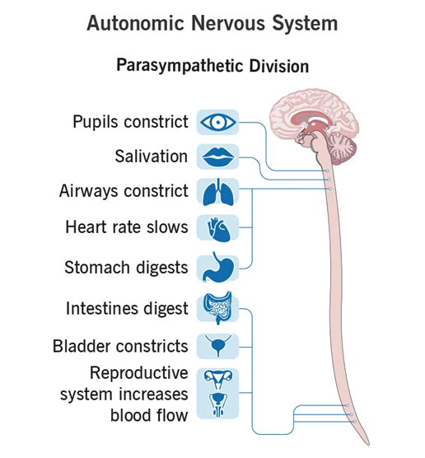
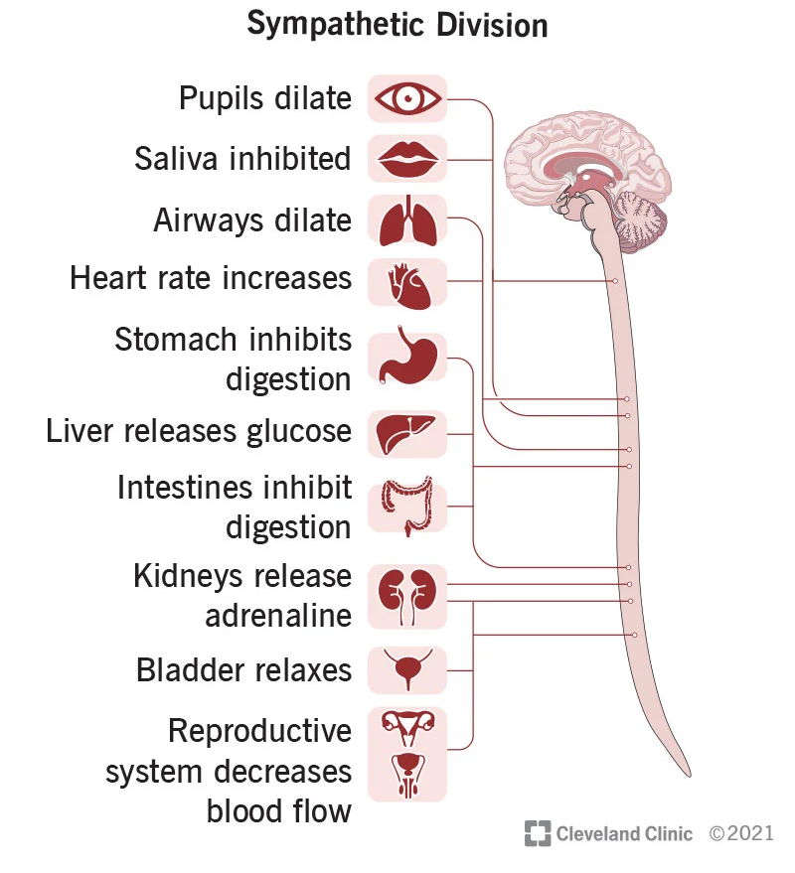

Slide 12
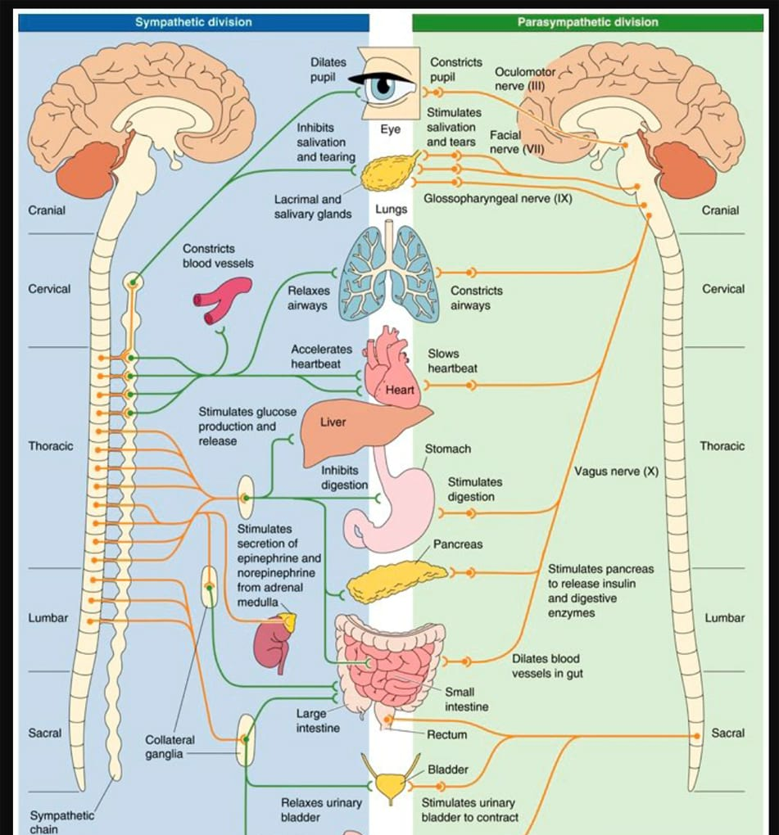

Slide 13
Somatic nervous system
Associated with voluntary processes that you have to think about, eg skeletal muscles
Stimulatory only.

Slide 14
Sensory pathways
Transmit information to the central nervous system from sensory organs and receptors within muscles
Muscle tension
Joint angle
Pain
Damaging stimuli eg heat or toxins
Adapted for special receptors such as hearing and vision

Slide 15
Motor pathways
Transmit information from the central nervous system to cause muscles to contract.

Slide 16
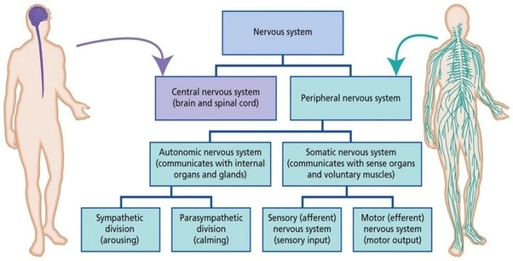

Slide 17
Success Criteria
Identify components of the peripheral nervous system
Define autosomal and somatic
Define parasympathetic and sympathetic
Define sensory and motor
Classify or give examples for each

